Slide 1

How to tear down
your documentation
(and rewrite docs that actually work)
Alexandra white | Documentation MANAGER, joyent
@HEYAWHITE #Writethedocs
slides: alexand.us/WTD18
Notes:
I’m here today to talk about tearing down your documentation, documentation that doesn’t work, documentation from legacy products, and documentation without a consistent brand identity. When you’ve torn it all down, you can write docs that actually work (for you, your colleagues, and your users).
But before I do that, I will tell you who I am and some backstory as to how I know what I know

Slide 2
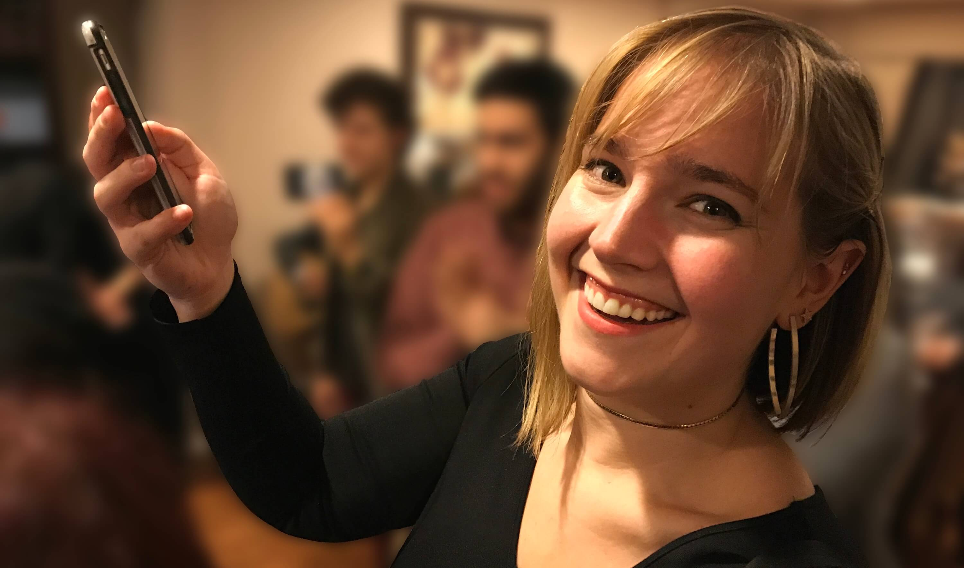
Hello
tweet me @heyawhite
#wRITETHEDOCS
Notes:
Hello. My name is Alexandra White, and I just got into Prague a few days ago from my home in New York City.
I became a full-time technical writer two years ago. Before that I was working as a web developer for a television station. When I started at my company, with a team of engineers who had been involved for five, ten, and fifteen years, I quickly learned there was a problem with a lack of knowledge transfer.
It was hard for me to start on any new project, having to constantly ask why things worked a certain way and how to find materials. I was a constant advocate for writing comments in code, writing helpful READMEs.
Facing this problem is what led me to my position at Joyent, a company with one of the earliest public clouds which even hosted Twitter in its earliest days.

Slide 3



Public
Hybrid
Private
Notes:
When I started at Joyent, I knew little to nothing about the cloud industry. I had attended a single conference about container infrastructure, but I barely understood the buzz words.
All of the sudden, I was expected to help other people understand how to use our products, without understanding the products myself.
I had to learn twice as fast.

Slide 4
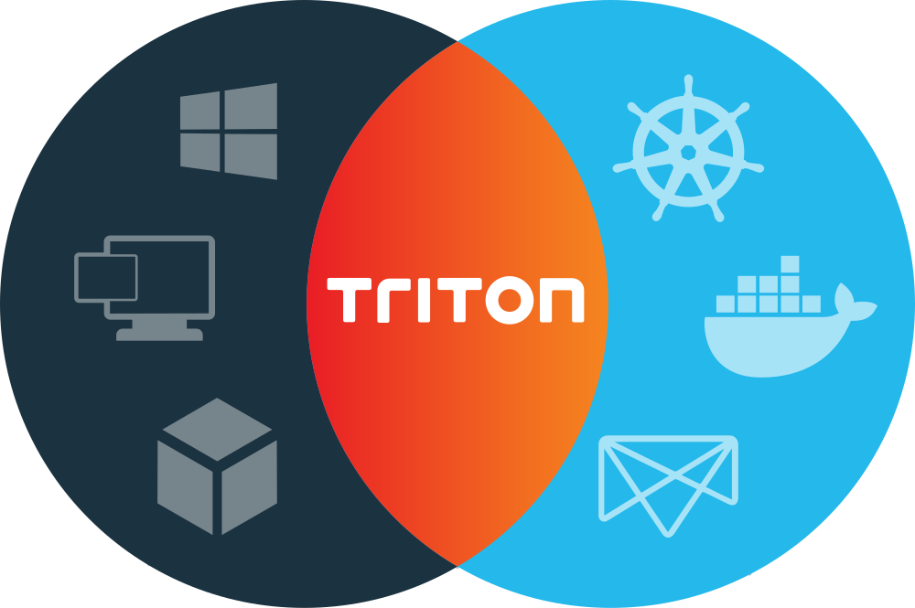
Notes:
Until 8 months ago, I was Joyent’s sole full-time documentation editor. Prior to my work, docs were created by engineers, product managers, and the support team.
They did the best they could, while juggling their own priorities, having to ship new features and solve problems for important customers.
But I inherited a mess, with thousands of documents online which needed to be organized and verified for accuracy. Plus, there was a complete lack of getting started materials. A key market of entry-level engineers, even if just entry-level to containers, was being ignored.
I got caught up as fast as I could, learning the way our products worked and taking on the big concepts of cloud and IT. I fought some immediate fires, creating a host of introductory Docker materials for our primary offering, Triton.
When I finally got my bearings, I was able to do my favorite thing: request to tear it down and start over.

Slide 5
How to tear DOWN YOUR DOCS
1. Writing a great proposal
2. Taking the proposal into action
3. Learning from what we missed
Notes:
During this talk I’ll tell you how I proposed to burn our docs to the ground and start over with better, cohesive, valid documentation. That meant writing a convincing proposal for my manager and his managers, as well as other stakeholders as to why this was the best use of my time.
Then I’ll talk about what happened when I took that proposal into action, including a big twist: how to deal with major change and external variables. Finally, I’ll talk about what was missed, so you make your docs even better.
Before we get started, I’m going to tell you the state of Joyent’s documentation two years ago so you really understand when I say, it needed to be burned to the ground.

Slide 6
9
0
documentation
websites
strategy or
guidelines
Notes:
In August 2016, I performed a content audit. I was overwhelmed.
Joyent had 9 documentation websites and 0 guidelines for how to write cohesive, tested documentation. It was difficult for our users to find the information they needed without significant effort or an intimate knowledge of the weird way those sites worked. Even our own internal engineers struggled to find basic answers.
Much of the 9 websites amounted to technical debt, content that was created, posted, and then forgotten about, therefore becoming out of date and misleading our customers.
Tomorrow you’ll hear Louise Fah-hee talk about tackling technical debt, and I look forward to hearing her strategy!

Slide 7
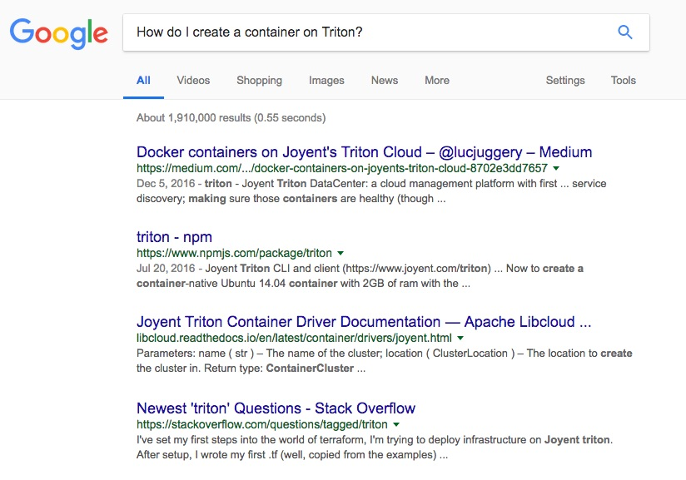
Notes:
When I wanted to know how to use a Joyent product, I had to either ask an engineer, or use a Google search. I’d cross my fingers the information would be up-to-date and not break the projects I was working on.
That should not have been my solution. Critical content and instructions were hidden on websites inaccessible to search and to the public, some of which I didn’t discover until a year into my tenure. Customers ended up on websites we didn’t own and couldn’t control, like answers on Stack Overflow, offering solutions which sometimes were outdated and incorrect.
I admit, I love Google search. Encouraging people to look on Google is often a great practice for learning a new technology. But when your content is so disorganized that even people at your company need to use it to find answers, there’s a problem.
We should feel confident we know where to get the correct information, and it should be directly from us.

Slide 8
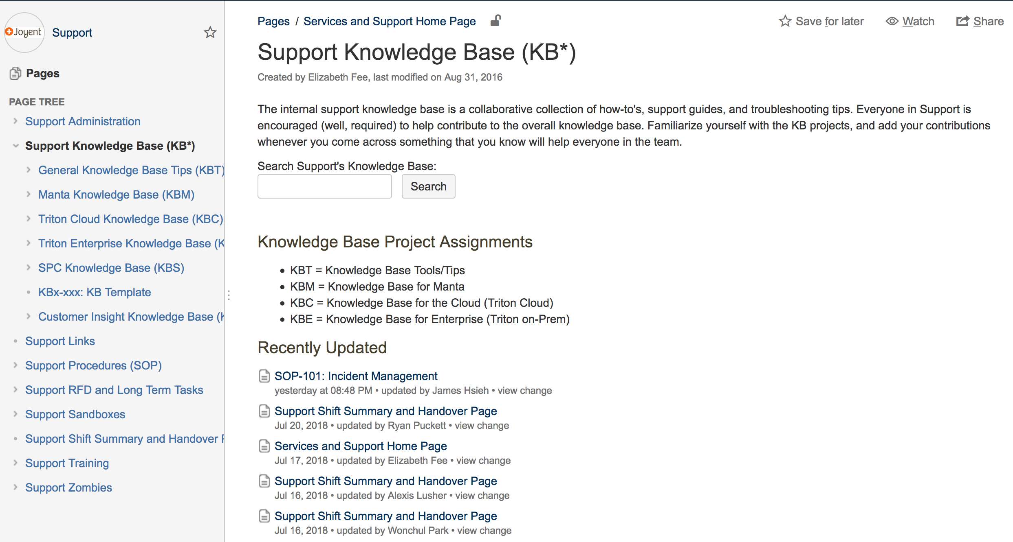
Notes:
I’m going to highlight a few of Joyent’s documentation-related websites to give a better understanding of where my colleagues produced work and what the information looked like.
First there was a wiki that was maintained by operations and support. The wiki is internal-only, and while it’s often the most up-to-date of all of our websites, understanding how to find info on this wiki was like a support team trade secret.
Some of the articles could have easily been live on a public docs site. Other articles were internal only. It was hard to know exactly where those lines were drawn.

Slide 9
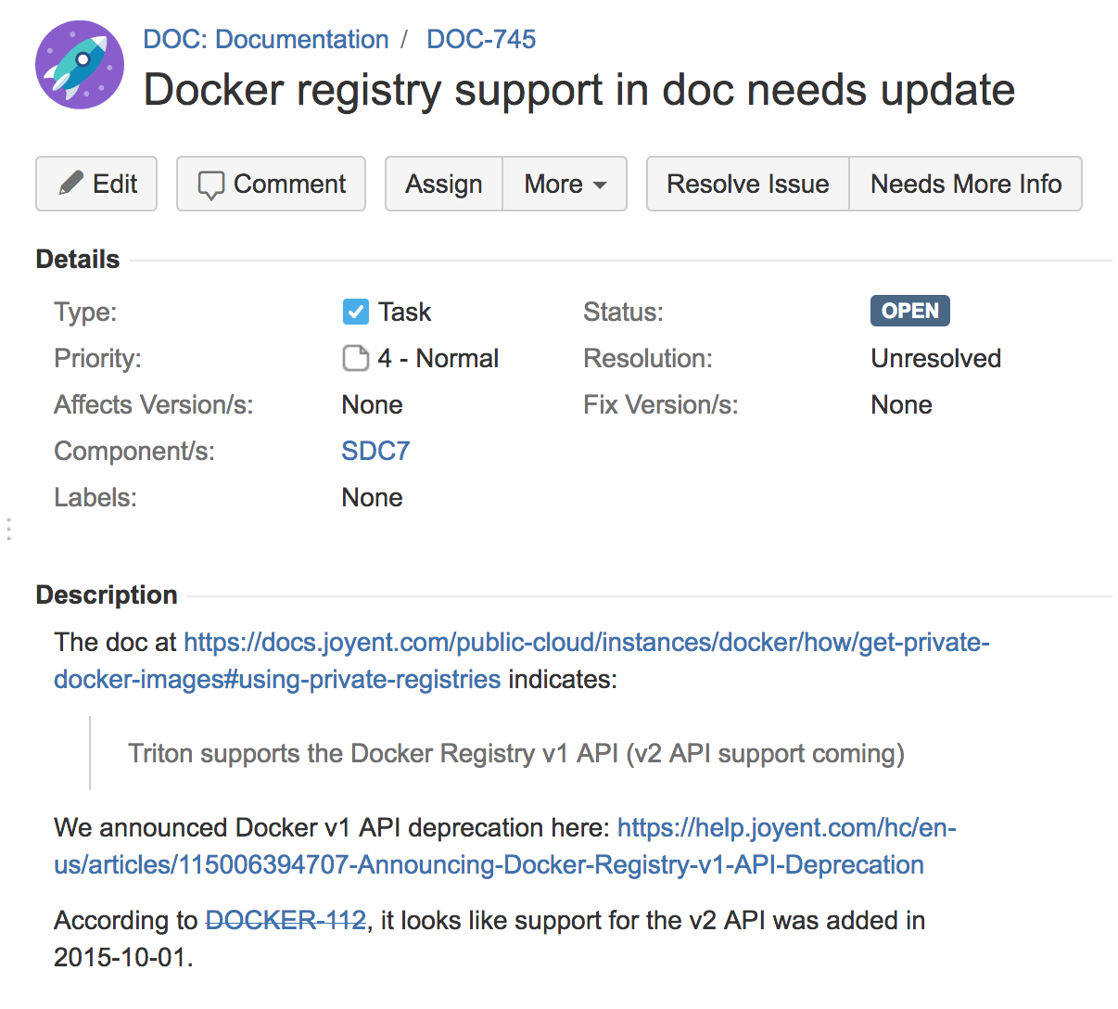
Notes:
Next, something you may be familiar with if you’re working in tech, the archive of JIRA tickets. There were thousands of open and closed JIRA tickets across subjects which often contained valuable knowledge never shared with the outside world.
Our support team or engineering team would take the time to fix a bug and document the new steps internally. Often that material did not make it to our documentation websites.

Slide 10
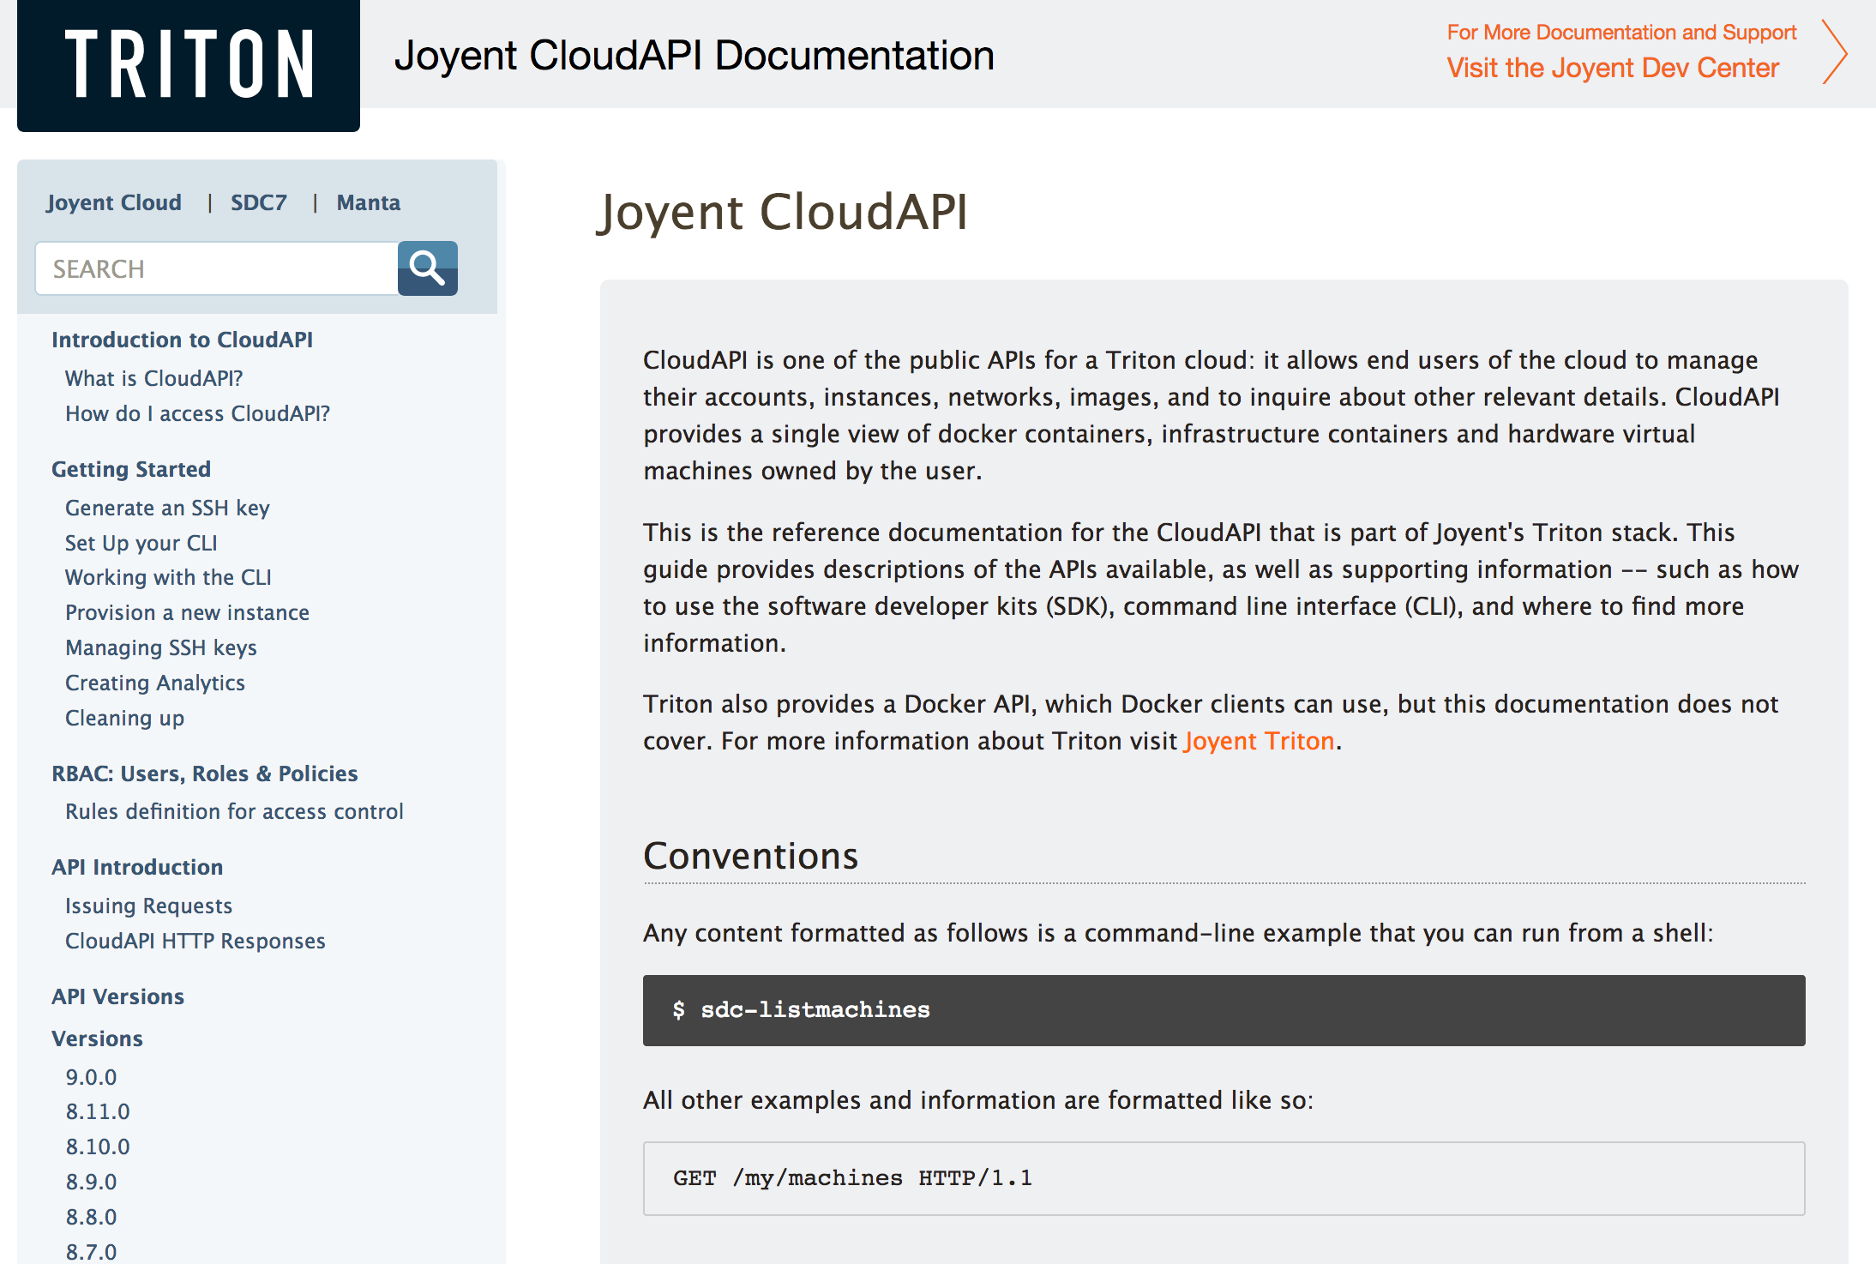
Notes:
We had 3 API websites which were single sourced from the code, being repurposed into a set of human-friendly documents.
On principle, this is great! I want my docs to be as close to our code as possible, so that if the code changes the docs can quickly change too. However, that wasn’t happening. Content wasn’t being updated with the code.

Slide 11
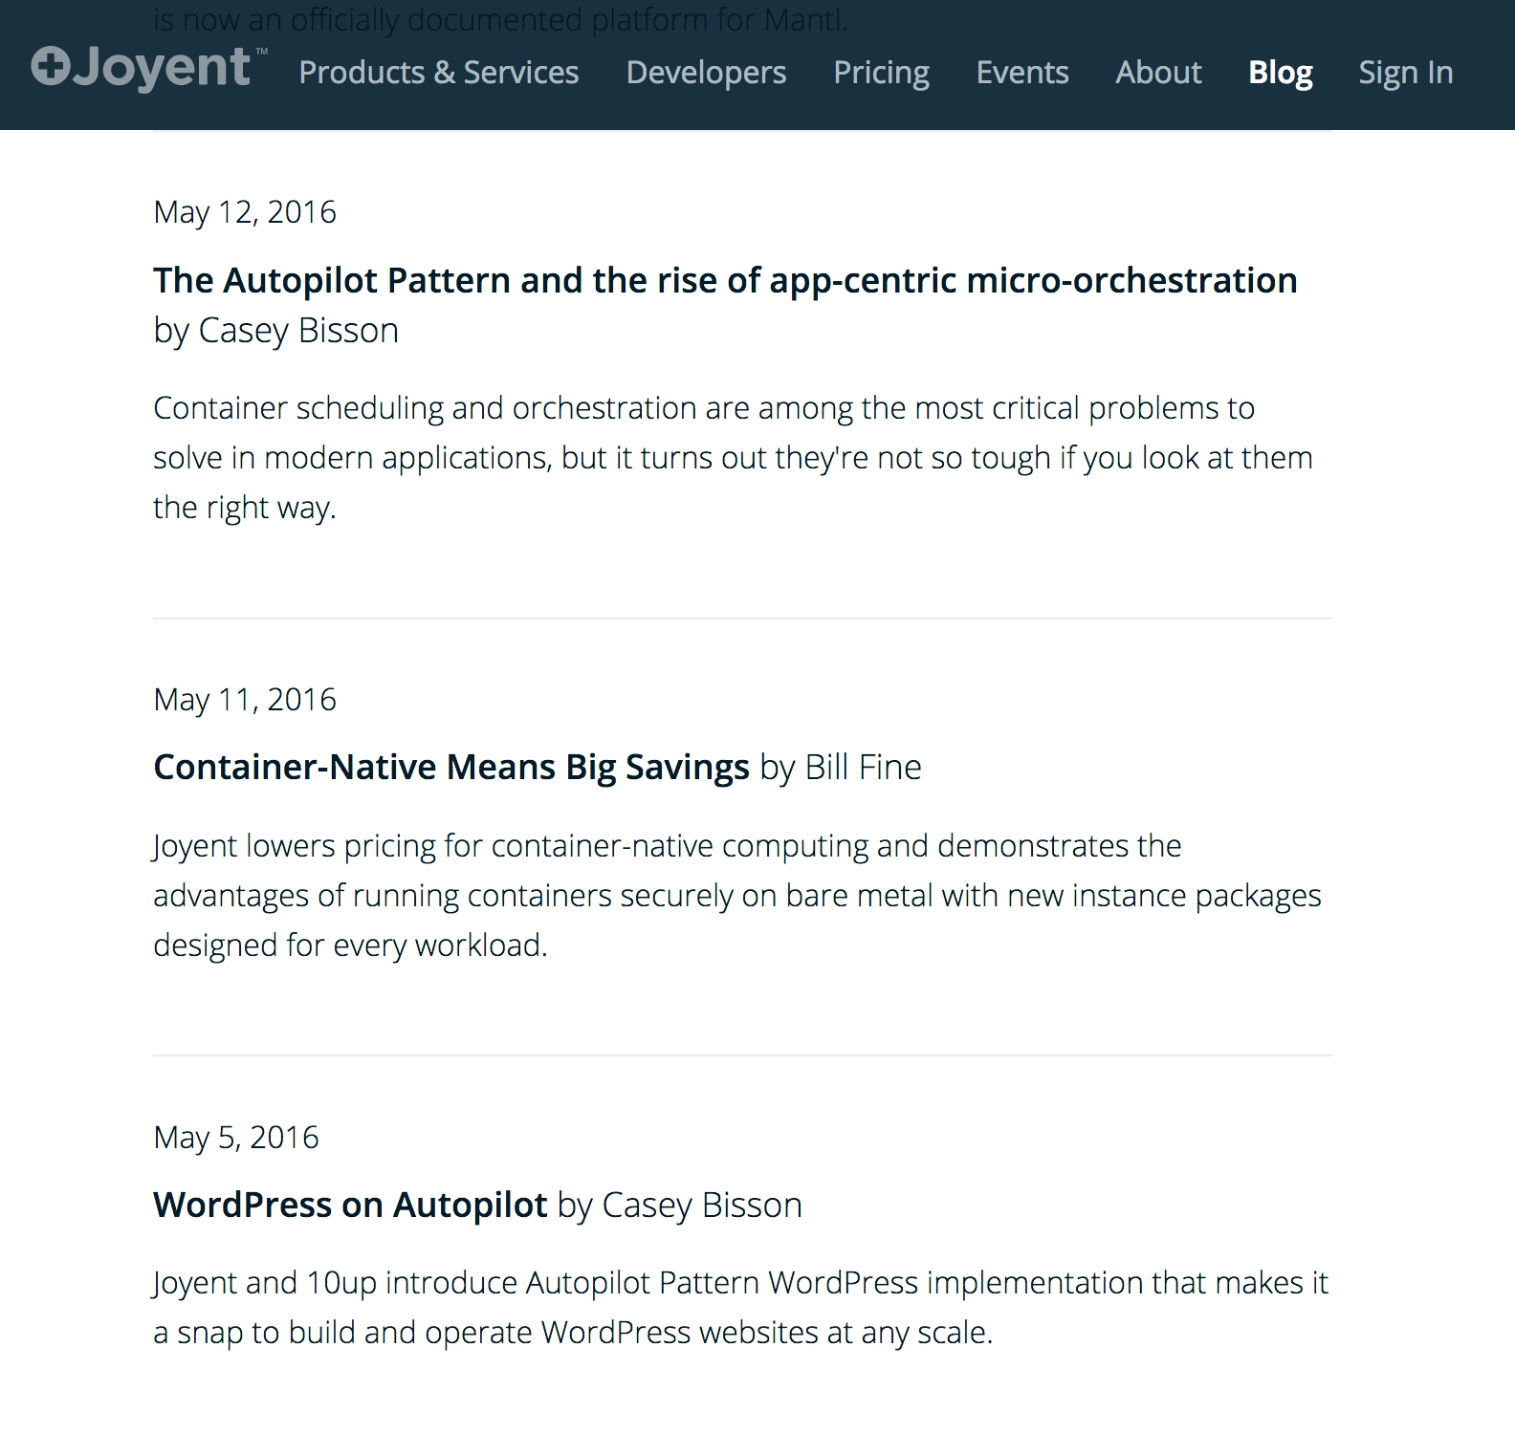
Notes:
Joyent’s blog was full of technical tutorials, instructions on how to use our products with popular applications, and full of conceptual overviews which explained container orchestration far better than anything under the actual “documentation” umbrella.
A blog can often be overlooked as just marketing material. And sure, this technical content had a “sell the product” spin, but valuable tutorials were being shared that customers wanted.

Slide 12
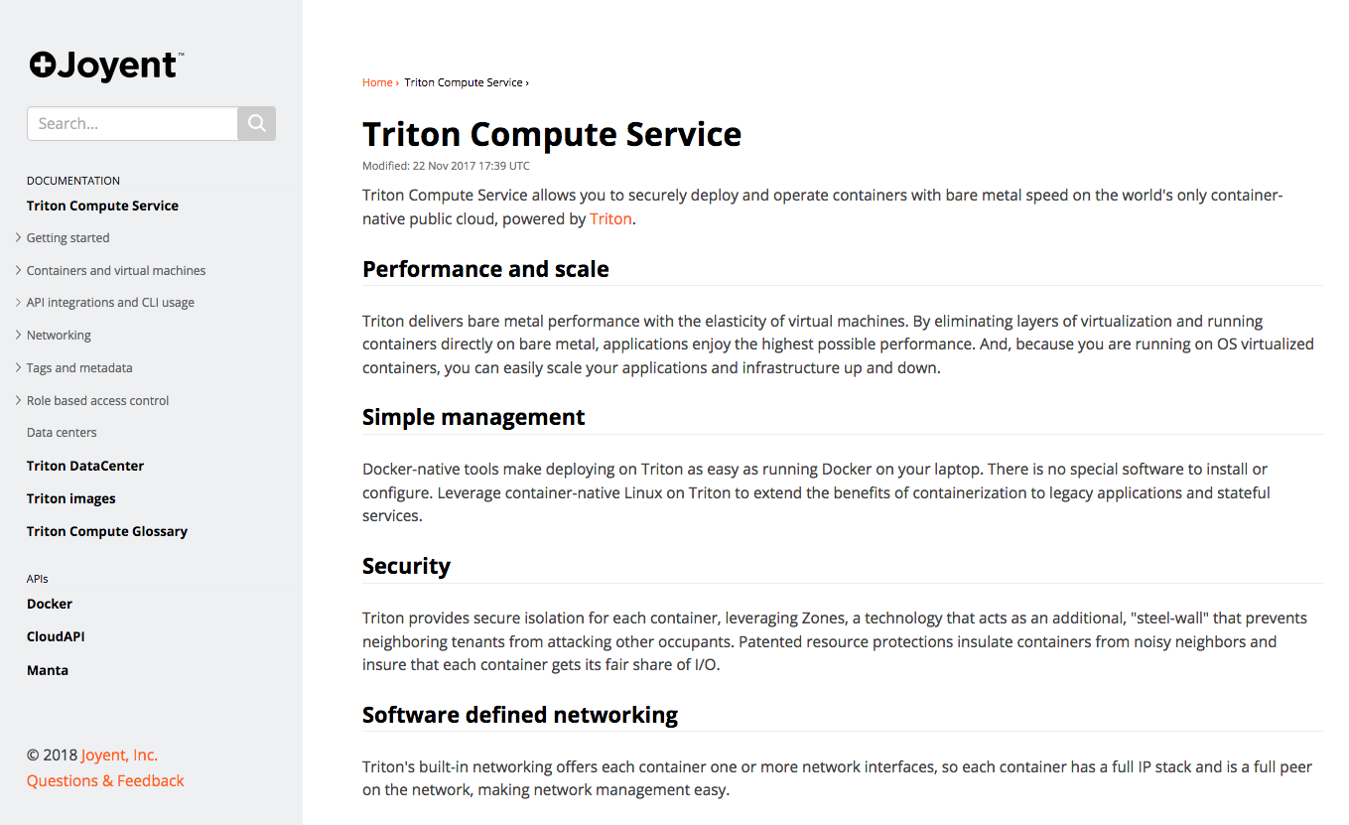
Notes:
Finally, our public docs site was maintained by the product team. This was supposed to be the primary resource for our customers to find answers to their problems.
But this site was not updated by the engineers, some of whom didn’t even know it existed.

Slide 13
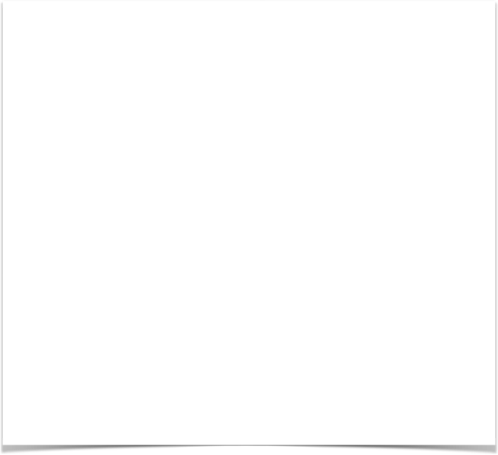
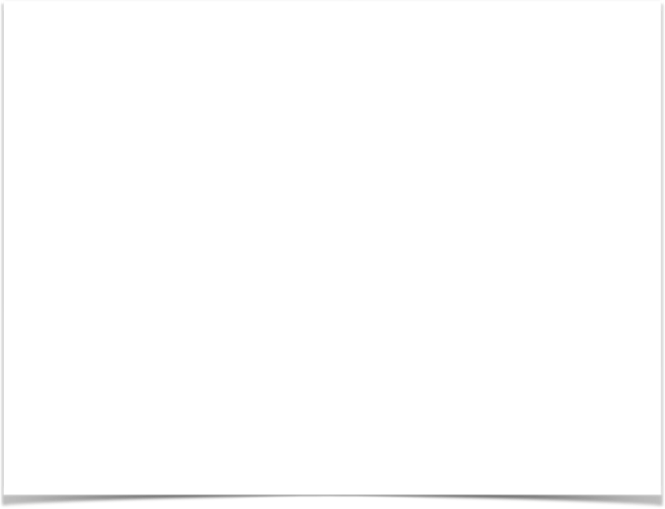
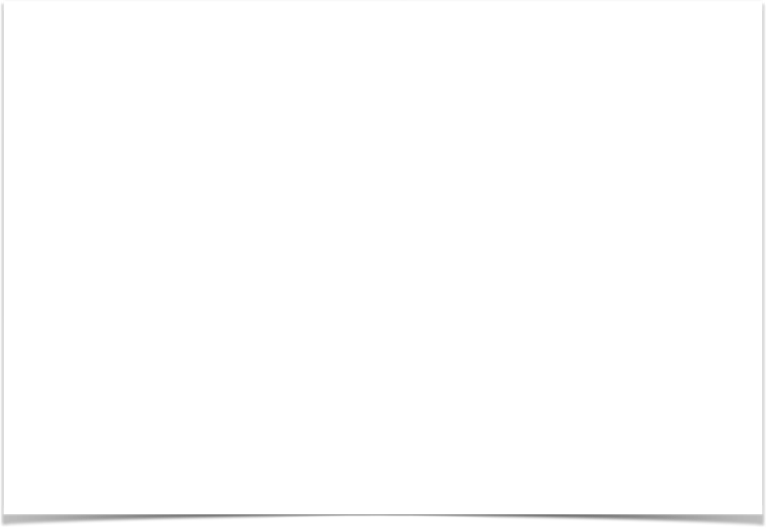
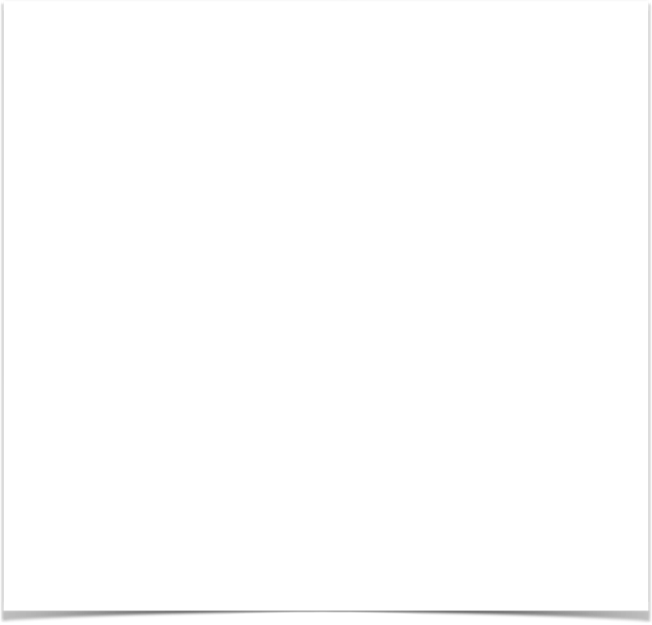
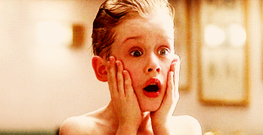
Notes:
None of the content had a life cycle plan. The content came from a bunch of different voices, the voices of our support team, engineers, and product team, rather than a singular Joyent voice.
All of the stakeholders had different opinions about how docs should work, where they should live.
No one tested these sites to see how customers used them and better understand what they needed. It was a terrifying, daunting mess.

Slide 14
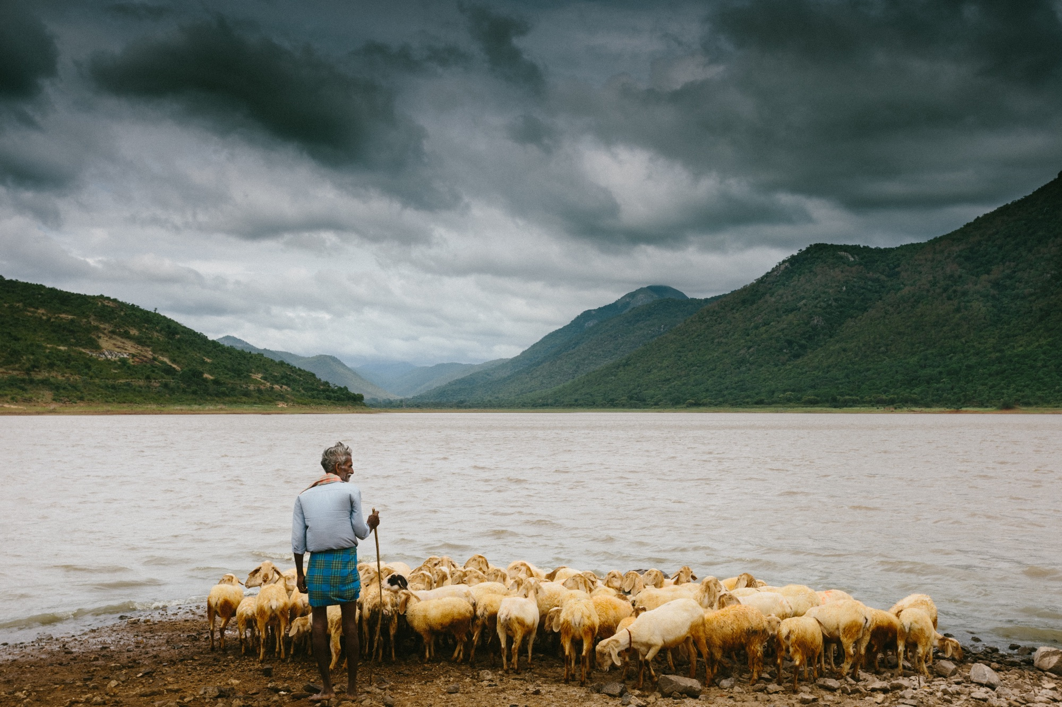
Technical writers are shepherds.
Notes:
But all messes can be fixed, either by cleaning them up or starting from scratch.
And our job as technical writers is to help our users find answers they need, whether it’s how to solve a problem in a moment of panic or how to understand the minutia of what products can make their every day workflow better.
It is also our job to help our colleagues write better. After all, we can’t be expected to be experts on every topic. We rely on our subject matter experts to know it all so that we can help our users understand what they NEED to know.
Technical writers are shepherds. We guide our users and our colleagues to better answers and practical solutions. And sometimes, the best solution is to start over. But with so much effort and investment in existing infrastructure, burning it down may seem like a risky proposition to stake holders.

Slide 15
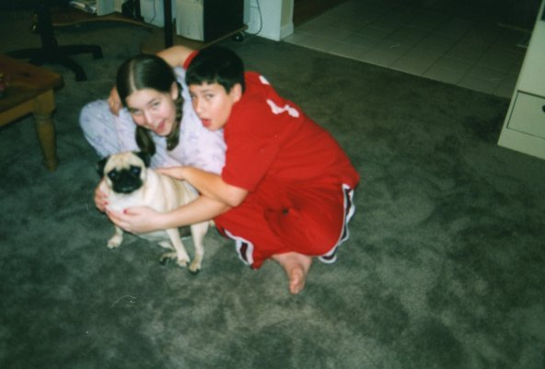
Quality argument =
puppy (or other prize)
Notes:
From a young age, I recognized the value of making a quality, researched argument. My brother and I desperately wanted a dog, but our father thought it would be too big of a burden. So how could I convince my dad that a dog would be a treasured family member instead of just an animal who required money and work?
My brother and I wrote a detailed argument as to why having a dog would make our family happier and how we would take on the shared responsibilities for feeding, walking, and cleaning up after the dog. We proposed a schedule and even proposed a way to work to pay for vet care with babysitting money.
As you can see, our argument worked. We adopted the most wonderful pug, Maggie, and she became a treasured family member.
Making a good argument for how to tear down your documentation to convince your managers you deserve the time and money is half of the battle to having good docs. After all, if you can’t convince them you need to do it, change won’t happen. A quality argument in this case is a well-crafted proposal.

Slide 16

1
Write a great proposal
Notes:
When you write a proposal, the audience is not yourself. It’s a marketing document for your managers that say,“this work is important and here’s why. This is how I will solve our problems and what the results will mean for our company’s bottom line.”
That said, the process of writing a proposal for tearing down your documentation will help you better understand the task at hand so you can efficiently solve the problems you’re facing, whether it’s missing content, unorganized documents, outdated information, or something else.
As I mentioned, there were a number of problems with Joyent’s documentation. But just because I knew our content was in bad shape, didn’t mean I could ignore our immediate customer needs. I was a team of one for a long time, and I didn’t have the luxury to be able to stop answering tickets while writing a plan and implementing new and improved docs.
But writing a proposal helped convince my manager that it was time well spent fixing the strategic problems with our documentation, so that in the future there would be fewer problems.
My proposal will act as our case study to help talk about getting the “yes” for tearing your docs down.

Slide 17
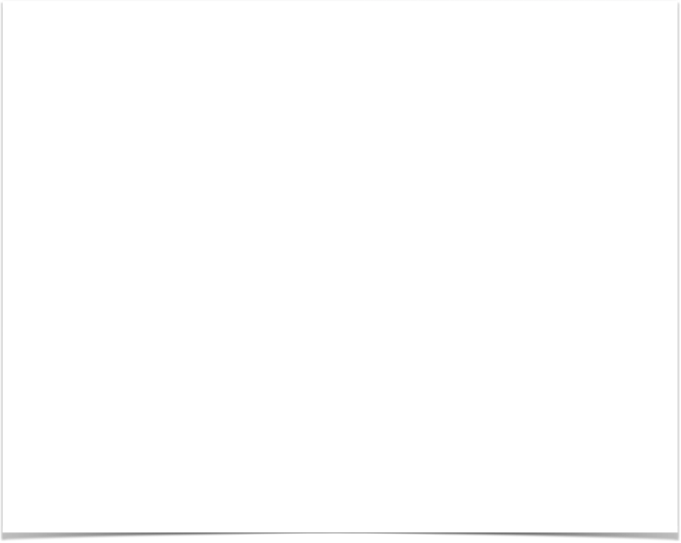
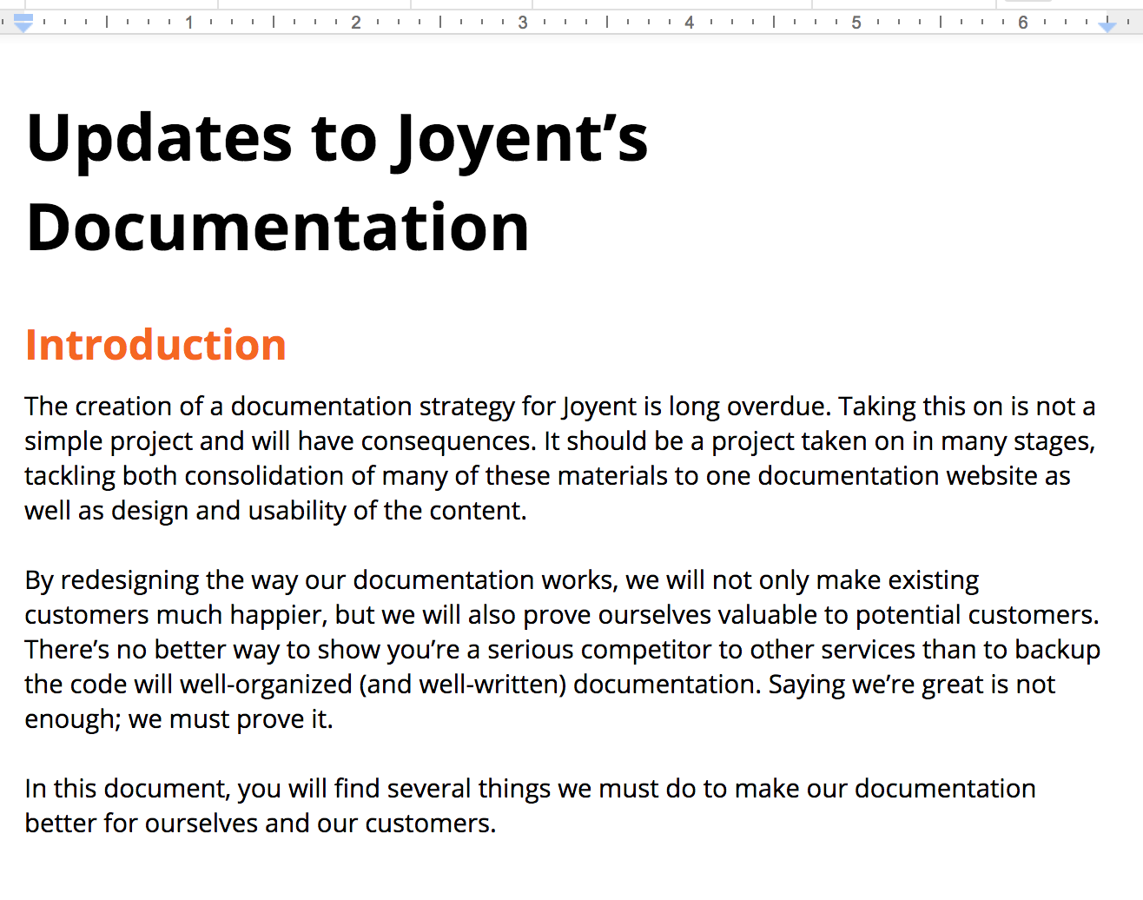
1. Proposals: Introduction
Notes:
First, great proposals always start with an introduction. You might be wondering why I’d start here, why does this really matter? Something I learned as a developer and as a marketing manager in what seems like a lifetime ago was that you have to hook your audience right away.
If they’re bored or unconvinced on the first page, they will leave no matter how clever your reasoning seems to you.
Introductions are the place for you to spell out the fact there is a problem and why the problem exists. Prepare the reader for what to expect in the next two, five, or ten pages.
In my first draft, I addressed the fact that Joyent was long overdue for a documentation overhaul and that there were far reaching problems with consequences. Perhaps you could expect that knowing there were 9 documentation websites.
I talked about why it was worth restructuring our documentation for the business. After all, Joyent’s company goal is to be a serious competitor in cloud, rather than a niche company for industry nerds. But just having marketing materials which say “we are the best” doesn’t make customers buy the product.
Backing up our claims was even more than having a good product. Even if it was the best cloud on the market, that wouldn’t matter if customers couldn’t use it.
Think about your company goals. Maybe your company is already the industry leader, so you don’t need to spend time convincing anyone to use the product but can focus on the exciting innovations your product offers. Maybe you don’t care about being the best, but rather you care about your customers being able to say it was so easy to get from point A to point B. Your introduction prioritizes the company goal for your documentation.

Slide 18
1. Proposals: Content Audit
docs.joyent.com, joyent.com, apidocs.joy, my.joyent.com, mo.joy, JIRA & Confluence, GitHub repositories, eng.joyent.com, Joyent’s wiki
Notes:
Before you can think about creating great documentation, you need to understand your company’s history of docs, how they succeeded and how they failed. Perform a content audit, and clearly outline where content exists and why the content is failing.
At Joyent, that meant listing all of the websites where we had content. I pointed out several of the most important assets earlier. What matters though was not the website URLs, rather the types of content on each site, the intended audience, the team responsible for maintaining it, and the method by which it was maintained.
I graded each site as to how helpful it was for the community it was supposed to support. And I made recommendations of what sites we should save, what sites should have content moved, and what sites should be shut down.

Slide 19

1. ProposalS: Audience
Business owners, investigators, problem solvers, detectives
Notes:
The number one focus of all of our work is our audience. They inform every decision we make. If you’re lucky enough that you’ve got a product or marketing department who has fleshed out personas for you, then you should certainly stick with those. For me, I found it helpful to divide the group into four goal-oriented categories.
First, business owners. Business owners are interested in our product and they want to know what our product does, understanding general concepts, and how easy it would be to start using the product with intro tutorials.
Second, our investigators. Investigators are the engineers who may be more familiar with Joyent and our cloud but want to learn the advanced features and how to use them.
Third, problem solvers. These are engineers who are in a bind and need to know how to solve a problem they’re having, fast. They need a quick tutorial, no nonsense no fluff.
Finally, detectives. These may be engineers or product managers who want to know if it’s possible to perform a specific task using our products.
By separating our audience into these four groups, I better understood their goals so I could craft new content which met their expectations.

Slide 20
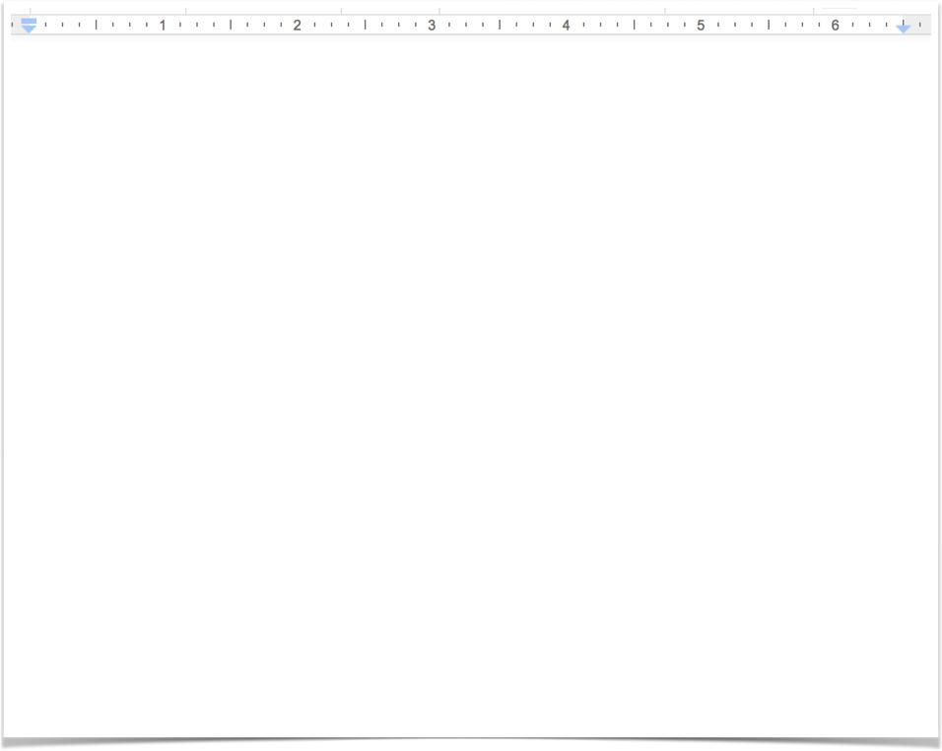
1. ProposalS: Objectives/goals
Joyent GOALS
Organize & save the “good” content.
Cohesive templates for different document styles.
Guidelines for internal requests for new documents.
Clear process for document deprecation.
Notes:
I had a number of goals in the documentation overhaul. Because our primary problem was the number of websites that contained docs, organizing and consolidating content was my first priority. That meant finding out what was the “good stuff”, what worked and what was worth saving.
I also needed to make it clearer to our readers what type of information they were about to read when they opened a new page. Having a specific template style which helped the reader know at a glance if content was a tutorial or a concept overview leads to clearer expectations.
Making this consistent throughout the docs helps gain our users trust that they will be able to find the information they need.
We needed internal goals, too, to help us make our docs cohesive and informative from the request process through completion. Writing guidelines for the request for docs helped set mandatory questions to better understand why a doc was needed and what critical information needed to be shared.
And no documentation plan is complete without addressing a plan for document deprecation: what happens when a document is out of date or covers a product that no longer exists? How do we archive these materials and when do we remove them completely?

Slide 21
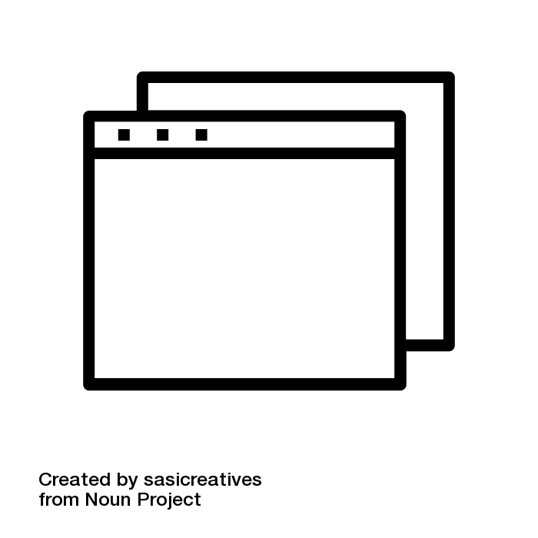
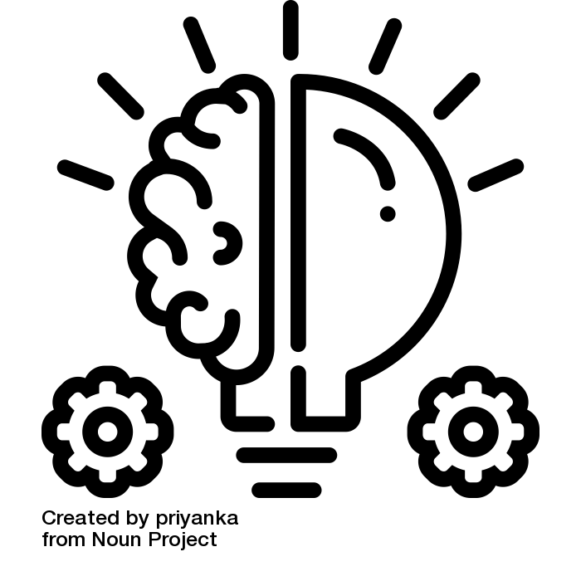
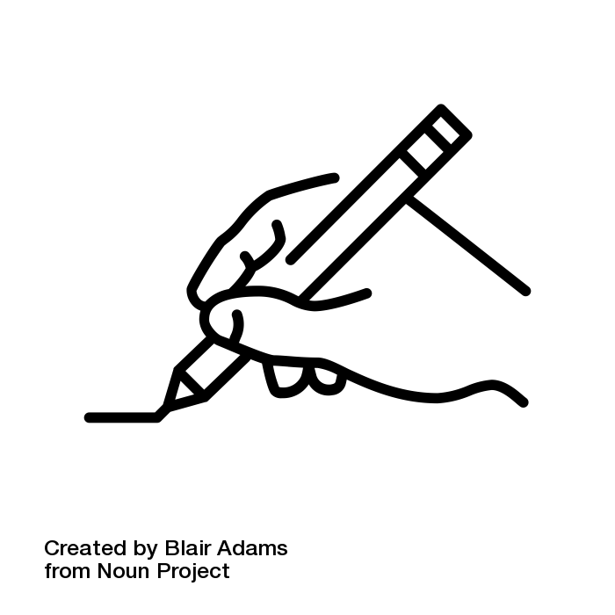
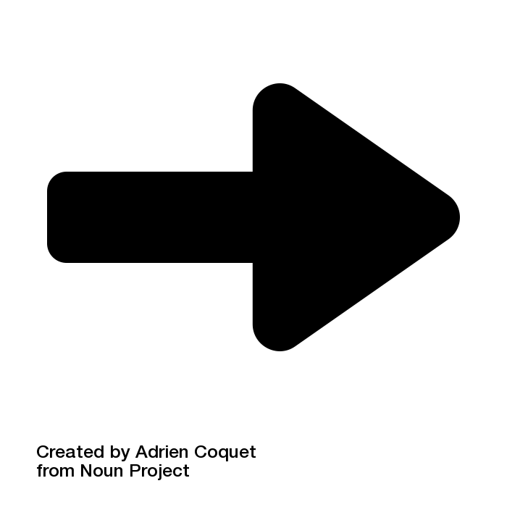
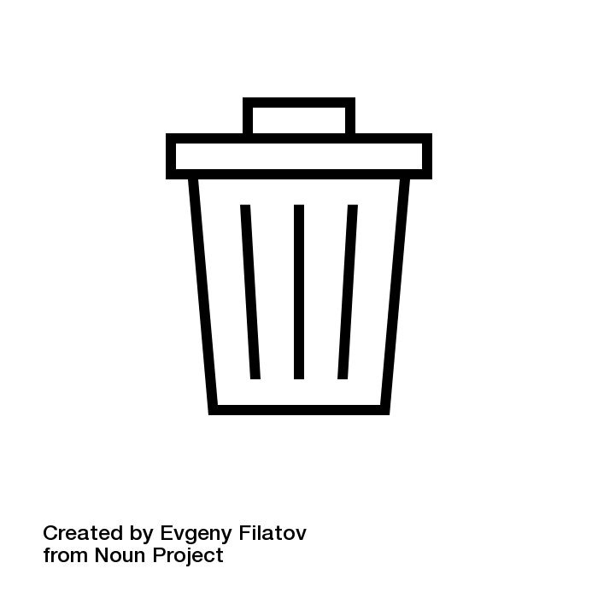
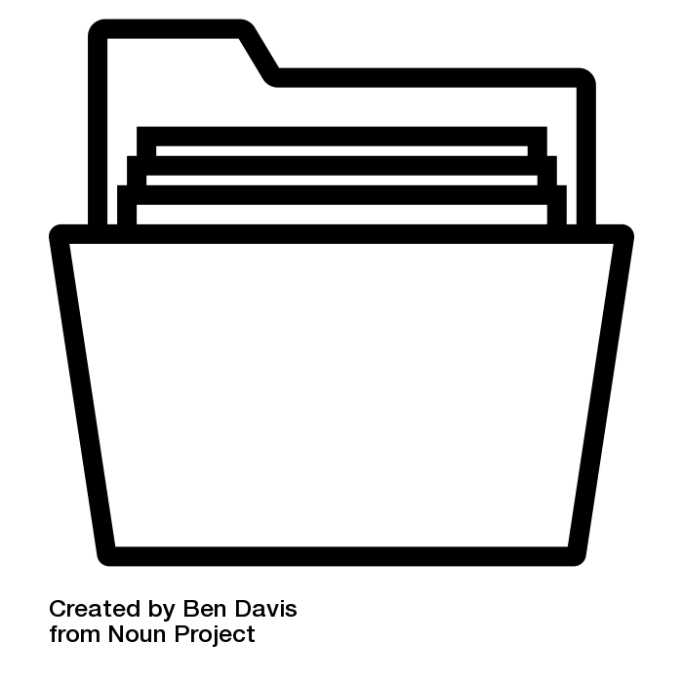
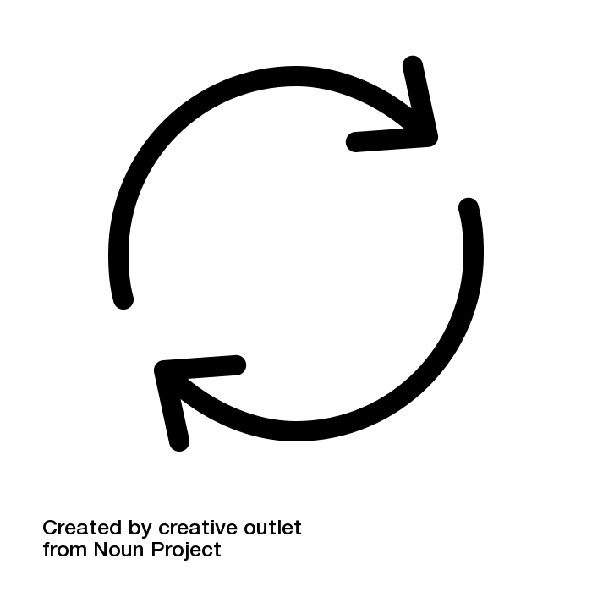
1. Proposals: Life cycle plan
Notes:
A lifecycle plan addresses what happens when a document is first written, how to update it, and what happens when the product it is relevant to either changes dramatically, goes into end of life, or is removed from the market place.
For Joyent, that meant considering what happened from the generation of an idea, to writing, to publishing, to updating, to archiving, to deletion. Each of those stages has a set of protocols to be followed and checks to ensure nothing is fully lost.
This may include how to add warnings to content, and how to think about redirecting users when a document goes offline.
=======================
ICONS Attributions
Idea by priyanka from the Noun Project
Writing created by Blair Adams from the Noun Project
website by sasicreatives from the Noun Project
archive by Ben Davis from the Noun Project
Trash by Evgeny Filatov from the Noun Project
Arrow by Adrien Coquet from the Noun Project

Slide 22
1. Proposals: Task list
Joyent documentation to-do
Project scope / definition
Why are we creating this content?
Personas, who is this aimed for?
What are the problems to solve?
Wants list: what do we need to create to satisfy our audience?
Content strategy
Site architecture / content organization
Wireframes
Visual design
Site development & launch
Notes:
Our task list set the expectations for work which would be completed and deliverables during the project. Not every task we performed led to an actual document. Some of our work was research — understanding the competitive cloud landscape, for example.
Amongst the things in my original to-do list were project scope, content strategy, site architecture, wireframes, visual design, and site launch.

Slide 23
1. Proposals: Wrap it up
Additional sections
Schedule
Tools required
Cost (time, money)
Additional considerations
Notes:
There are a number of additional sections that made it into my final proposal that don’t require the weight of review, including a schedule for deliverables, breakdown of the cost in time and money, and a list of additional considerations, otherwise known as, “what have we forgotten or what do we still need to decide?”
The big question in that section is, “do we open source everything?”

Slide 24
Proposal = Buy-in
Notes:
At the end of the day, whether your proposal is long and full of similar details to mine, or if it’s simpler like “Alexandra and Philip should have a dog because we will be happier and so will you,” it’s important that your proposal makes it clear the reason you deserve to tear down your docs, how you will solve the problem, and in what time frame you will solve it.

Slide 25

2
proposal in action
Notes:
Once you’re proposal is done and you’ve impressed your manager, and they give you all the money and all the time… what next?
All of that planning was great. Having a proposal informs your work for specific products. Some of the work you do can be reusable, in fact most of my proposals have served as templates for future work.

Slide 26

Strategy
Content strategy
2. Proposal in action
Notes:
Now it’s time to put all of the pieces together. Content strategy is the natural next step from your proposal. In fact, so much of the work to create a content strategy has already been done.
6 years ago I worked as the digital marketing manager for a national nonprofit. In many ways, marketing and technical content are different. The goals of marketing is to sell you something, the goals of technical content is to help you learn or accomplish a task. However, we can use marketing techniques to help our users succeed.
Your content strategy should create consistency for your brand. When a user uses your products, looks at the marketing website, reads FAQs or documentation, all of it should feel like it’s from a singular brand.

Slide 27
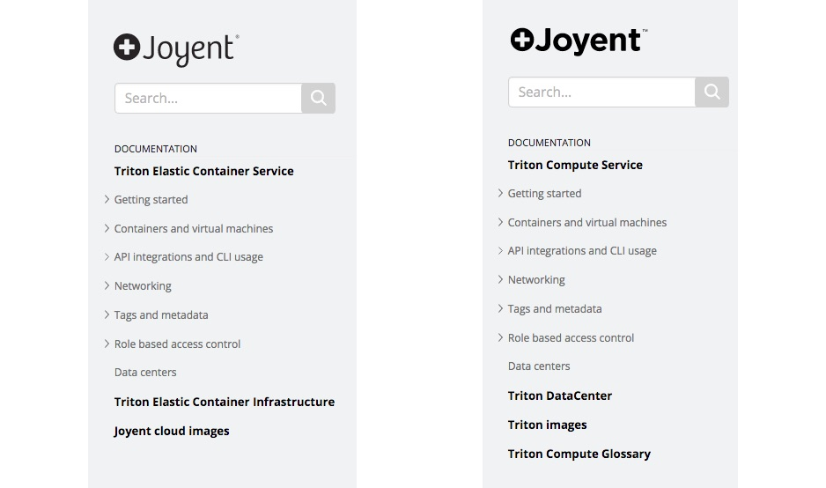
2. PROPOSAL IN-ACTION: DOCS SITE
2016
2018
Notes:
For example, here’s the sidebar on docs.joyent.com from when I started compared to now. To be fair, the services have been renamed a couple of times since I began, but making sure that the public product, i.e. Triton Compute Service, is consistently updated is important.
On the left, one of the items in the menu is Joyent cloud images. This was leftover from a previous iteration of the cloud’s name, Joyent Public Cloud or JPC. I updated it to be Triton images to match the product name versus the company name.
There’s a company name culture problem that persists today. It’s a battle my boss and I fought and lost many times. People call the cloud JPC, and much of the legacy code uses the acronym. It’s hard to leave naming decisions behind. But at least on the outside, our docs could reflect the appropriate product name.

Slide 28
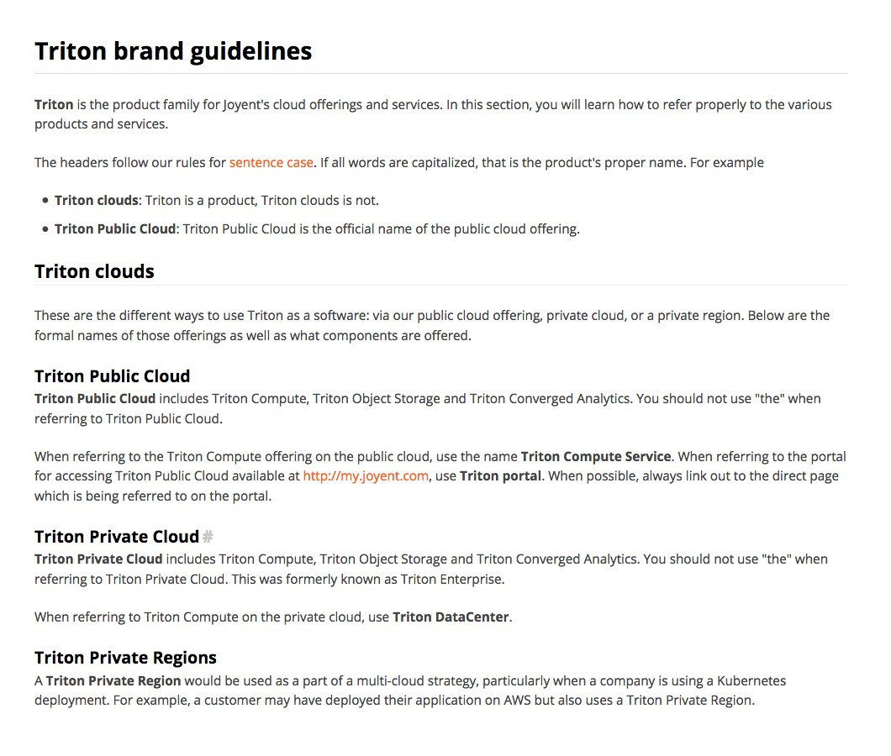
2. Proposal in action: writing rules
2016
2018
Notes:
Speaking of product names, it’s important to articulate rules on how to use the official names as well as a controlled vocabulary which help establish consistency for user learning.
This can be part of a style guide, to help us standardize the way we talk about ourselves as well as the way we talk about other brands, like Docker.
Style guides can also help you pre-establish writing conventions like voice and tone, grammar rules, text styles, UI rules, and rules for accessibility. By doing this work before you write the docs and before your colleagues write their own drafts, you can help better the first draft quality.

Slide 29
2. Proposal in action: Trash it, trash it all!
Notes:
Another key part of my strategy was to rid our docs of all clearly outdated and deprecated materials. I sent out notifications to various teams that if content hadn’t been updated in over two years, it was going to be subject to deletion.
But then I didn’t *really* delete it. I just removed it from the online server and put it in an archive. Until I was absolutely sure the content was no longer valuable.
=======================
ICONS Attributions
Trash by Evgeny Filatov from the Noun Project

Slide 30

Notes:
This is where the story gets interesting.
Joyent is a subsidiary of Samsung, which means that our highest stakeholder are our counterparts in Korea.
After almost two years working on a certain part of Joyent’s documentation, I was asked to leave much of my work behind in favor of starting on a brand new project. That meant archiving the proposal and content strategy that I had been meticulously building from my intimate knowledge of our products. I stopped working on my pull request which had a re-organized, task-oriented version of the Joyent documentation website.
Almost all of the websites I mentioned at the beginning of the talk, the ones that were outdated or with hidden information, remain online exactly as they existed before this project began.
But, I took what I learned from this process and started over fresh on my new project.

Slide 31

Nothing is precious.
“TheOneRing2_77” by Reuben Flounders is licensed under CC BY 2.0.
Notes:
Sometimes you have to throw away all of the work you do because of unpredictable circumstances.
Don’t feel so attached to your material that you’re not ready to give it all up in an instant. Remember, nothing should be precious. Take the lessons you learned and apply them again to future projects.

Slide 32

3
what we missed
Notes:
Despite having to halt my Joyent documentation overhaul, I still learned several valuable lessons. Part of that was realizing there were key topics that I missed.

Slide 33

what we missed
Accounting for user testing
User testing
3. What we missed
Notes:
First was accounting for user testing. Honestly, it’s something I wanted to include as a first-tier priority, with budget for software and time to speak to our users about what they liked and didn’t like about our docs.
Furthermore, I wish I had talked more to my colleagues about what they liked and didn’t like about our docs. After all, our employees are users of our docs, too, and their voice matters. By incorporating them into this process, they would have had more reason to help me create better docs.
I know user testing is important. Even just having a survey sent out, some very low-touch work to get a sense of how people felt and what they wanted to see. I should have pushed this priority.

Slide 34

what we missed
On-boarding & team empathy
Team empathy
& on-boarding
3. What we missed
Notes:
Even more important is the idea of empathy for your engineering team. How do we facilitate our colleagues writing quality content so that we can focus on larger strategy and additional support content?
There are a number of ways we should be considering on-boarding our colleagues into writing documentation, getting their buy-in as to why its important. If we want them to stop using Google search to find answers, we have to help them create the answers.
Also, remember that even your colleagues who believe docs are important have other priorities. They’re busy. They have goals to meet for their bosses. They have to complete other work and helping you may be last on their list.
Be nice to them, and try to give them support.

Slide 35

Better writing
Culture of documentation
Culture of documentation
3. What we missed
Notes:
Perhaps what’s most difficult in helping engineers and SME’s write documentation is making sure they understand it’s important. The best than that, is a company with a culture of documentation.
Documentation is everyone’s job, not just ours. If everyone in our organization is empowered to help users solve problems, our products will be better.

Slide 36

Diversity matters
3. What we missed
Notes:
It was crucial for Joyent to understand the thought patterns of employees in Samsung in Korea. The way they may search for information and try and solve problems was often different from the way we did.
Our documentation is affected by our culture. In fact, all writing is affected by the way we learn and the way we believe others should learn.
Diversity is important. Having people from diverse backgrounds means you are more likely to address different forms of learning and create better content overall. There’s a lot of room for growth in this area.

Slide 37
Notes:
This slide is blank on purpose! Take a breath everyone, we’re almost at the end.

Slide 38
How we TORE IT DOWN
1. Writing a great proposal
2. Taking the proposal into action
3. Learning from what we missed
Notes:
Before we wrap up, I want to remind you of the things we talked about today. We talked about how to write a great proposal, first steps to taking that proposal into action, and things that I missed in my process that you shouldn’t miss in yours.
If you remember nothing else from this talk, remember the following take-aways.

Slide 39
Having a plan is the only way you will succeed.
Notes:
Plans are the keys to your success. That includes a proposal and strategy documents. All of these inform the decisions you make in the writing process and shape the way your audience reads your materials.

Slide 40
Be okay with throwing out your work.
Notes:
Sometimes good plans don’t matter because other things interfere. Sometimes you do a lot of hard work and a product goes out of production. It’s okay to throw out the end results of your process because if you did your homework right, you’ll be ready to start creating materials for a new product in half the time.

Slide 41
Your work is important. You are important.
Notes:
Documentation is critical, both for our users and for engineers. You have critical skills which help everyone understand complicated concepts and processes. Your work is valuable. You are valuable. Even if you aren’t told this by a regular basis, remember you’re surrounded by a bunch of people struggling with some of the same problems. Ask us for help.

Slide 42
Be a shepherd.
Notes:
And remember, you’re a shepherd. You’re helping lead your users and your colleagues to the answers that they need.

Slide 43
thank you
Slides: alexand.us/WTD18
Tweet me @heyawhite with #writethedocs

Slide 44
Useful links
Joyent’s style guide
voiceandtone.com by MailChimp
Microsoft document planning
Photography & Iconography
unsplash.com
thenounproject.com

